Slide 1
DATA MINING
Dr. Oluwatosin Oluwadare, 2024
Department of Computer Science , University of Colorado, Colorado springs.
CS 4434/5434 and dase 4435
Data Mining,
Fall 2024
Lecture 7– 8: Frequent Pattern Analysis
Slides Adapted from Jiawei Han et al. and Jianlin Cheng

Slide 2
Data Mining:
Concepts and Techniques
(3rd ed.)
— Chapter 6 —
Jiawei Han, Micheline Kamber, and Jian Pei
University of Illinois at Urbana-Champaign &
Simon Fraser University
©2011 Han, Kamber & Pei. All rights reserved.
2
Notes:
2

Slide 3
Chapter 5: Mining Frequent Patterns, Association and Correlations: Basic Concepts and Methods
Basic Concepts
Frequent Itemset Mining Methods
Which Patterns Are Interesting?—Pattern Evaluation Methods
Summary

Slide 4
What Is Frequent Pattern Analysis?
Frequent pattern: a pattern (a set of items, subsequences, substructures, etc.) that occurs frequently in a data set
First proposed by Agrawal, Imielinski, and Swami [AIS93] in the context of frequent itemsets and association rule mining
Motivation: Finding inherent regularities in data
  What products were often purchased together?— Beer and diapers?!
  What are the subsequent purchases after buying a PC?
  What kinds of DNA are sensitive to this new drug?
  Can we automatically classify web documents?
Applications
  Basket data analysis, cross-marketing, catalog design, sale campaign analysis, Web log (click stream) analysis, and DNA sequence analysis.

Slide 5
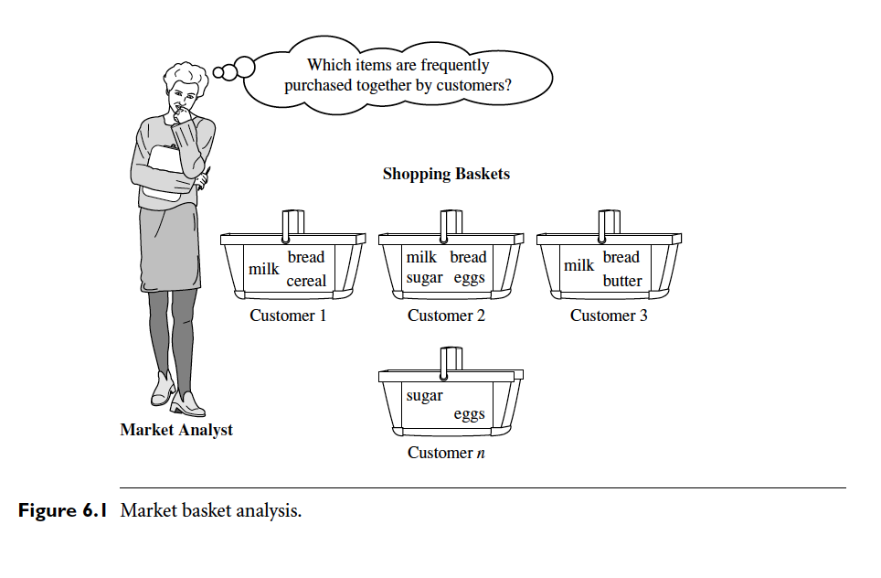
Market Basket Analysis

Slide 6
Why Is Freq. Pattern Mining Important?
Freq. pattern: An intrinsic and important property of datasets
Foundation for many essential data mining tasks
  Association, correlation, and causality analysis
  Sequential, structural (e.g., sub-graph) patterns
  Pattern analysis in spatiotemporal, multimedia, time-series, and stream data
  Classification: discriminative, frequent pattern analysis
  Cluster analysis: frequent pattern-based clustering
  Data warehousing: iceberg cube and cube-gradient
  Semantic data compression: fascicles
  Broad applications

Slide 7
Basic Concepts: Frequent Patterns
Tid | Items bought
10 | Beer, Nuts, Diaper
20 | Beer, Coffee, Diaper
30 | Beer, Diaper, Eggs
40 | Nuts, Eggs, Milk
50 | Nuts, Coffee, Diaper, Eggs, Milk
itemset: A set of one or more items
k-itemset X = {x₁, …, x_{k}}
(absolute) support, or, support count of X: Frequency or occurrence of an itemset X
(relative) support, s, is the fraction of transactions that contains X (i.e., the probability that a transaction contains X)
Customer
buys both
Customer
buys diaper
Customer
buys beer

Slide 8
Frequent Itemset
Frequent Itemset: is an itemset whose support value is greater than a threshold value
An itemset X is frequent if X’s support is no less than a minimum support (minsup) threshold

Slide 9
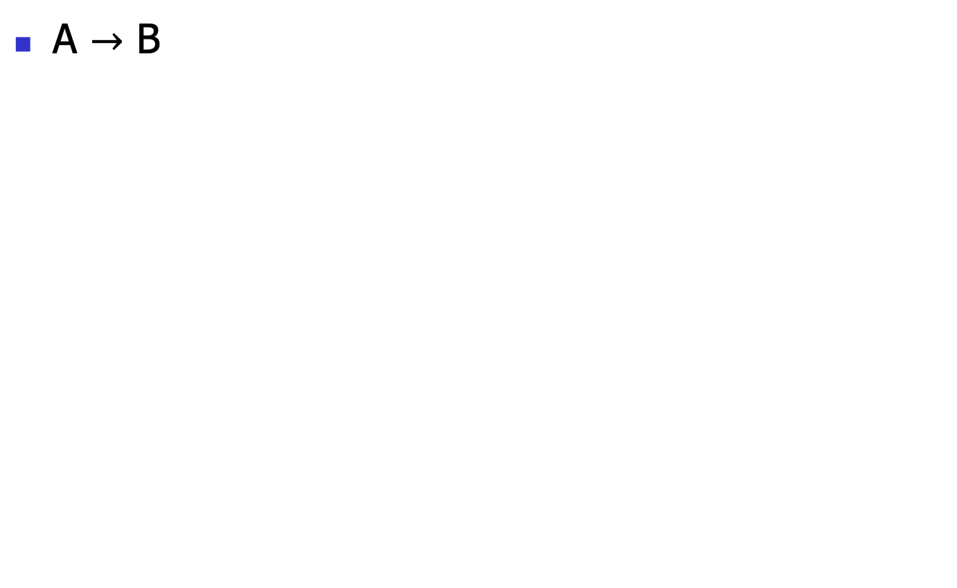
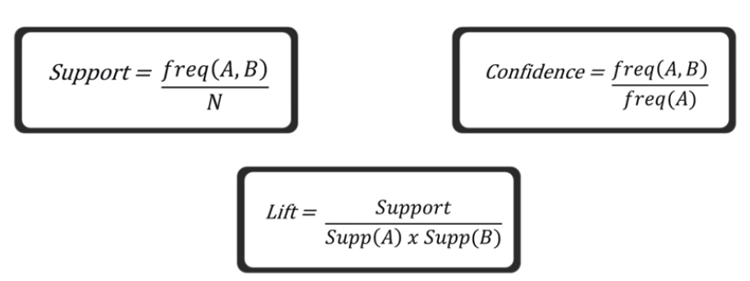
Basic Concepts: Association Rules
Support
IF
THEN
Measure
Association
Confidence
Lift

Slide 10
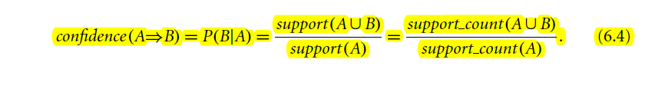
Basic Concepts: Association Rules
Tid
Items bought
Find all the rules X → Y with minimum support and confidence
  support, s, probability that a transaction contains X ∪ Y
  confidence, c, conditional probability that a transaction having X also contains Y
Let minsup = 50%, minconf = 50%
Freq. Pat.: Beer:3, Nuts:3, Diaper:4, Eggs:3, {Beer, Diaper}:3
10
Beer, Nuts, Diaper
20
Beer, Coffee, Diaper
30
Beer, Diaper, Eggs
40
Nuts, Eggs, Milk
50
Nuts, Coffee, Diaper, Eggs, Milk
Customer
buys both
Customer
buys diaper
Customer
buys beer
Association rules: (many more!)
  Beer → Diaper (60%, 100%)
  Diaper → Beer (60%, 75%)

Slide 11
Closed Patterns and Max-Patterns
A long pattern contains a combinatorial number of sub-patterns, e.g., {a₁, …, a₁₀₀} contains (₁₀₀¹) + (₁₀₀²) + … + (₁¹₀⁰₀⁰) = 2¹⁰⁰ – 1 = 1.27*10³⁰ sub-patterns!
Solution: Mine closed patterns and max-patterns instead
An itemset X is closed if X is frequent and there exists no super-pattern Y כ X, with the same support as X (proposed by Pasquier, et al. @ ICDT’99)
An itemset X is a max-pattern if X is frequent and there exists no frequent super-pattern Y כ X (proposed by Bayardo @ SIGMOD’98)
Closed pattern is a lossless compression of freq. patterns
  Reducing the # of patterns and rules
Notes:
A major challenge in mining frequent itemsets from a large data set is the fact that such mining often generates a huge number of itemsets satisfying the minimum support
(min sup) threshold, especially when min sup is set low. This is because if an itemset is frequent, each of its subsets is frequent as well.

Slide 12
Closed Patterns and Max-Patterns
Exercise. DB = {<a₁, …, a₁₀₀>, < a₁, …, a₅₀>}
  Min_sup = 1.
What is the set of closed itemset?
  <a₁, …, a₁₀₀>: 1
  < a₁, …, a₅₀>: 2
What is the set of max-pattern?
  <a₁, …, a₁₀₀>: 1
What is the set of all patterns?
  !!
Notes:
{a2, a45}, {a8, a 55} From maximal frequent itemset, you can assert the times that are frequest but does not give a complete information regarding their actual count.

Slide 13
Computational Complexity of Frequent Itemset Mining
How many itemsets are potentially to be generated in the worst case?
  The number of frequent itemsets to be generated is senstive to the minsup threshold
  When minsup is low, there exist potentially an exponential number of frequent itemsets
  The worst case: M^{N} where M: # distinct items, and N: max length of transactions
The worst case complexty vs. the expected probability
  Ex. Suppose Walmart has 10⁴ kinds of products
    The chance to pick up one product 10⁻⁴
    The chance to pick up a particular set of 10 products: ~10⁻⁴⁰
    What is the chance this particular set of 10 products to be frequent 10³ times in 10⁹ transactions?

Slide 14
Chapter 5: Mining Frequent Patterns, Association and Correlations: Basic Concepts and Methods
Basic Concepts
Frequent Itemset Mining Methods
Which Patterns Are Interesting?—Pattern Evaluation Methods
Summary

Slide 15
Scalable Frequent Itemset Mining Methods
Apriori: A Candidate Generation-and-Test Approach
Improving the Efficiency of Apriori
FPGrowth: A Frequent Pattern-Growth Approach
ECLAT: Frequent Pattern Mining with Vertical Data Format

Slide 16
The Downward Closure Property and Scalable Mining Methods
The downward closure property of frequent patterns
  Any subset of a frequent itemset must be frequent
  If {beer, diaper, nuts} is frequent, so is {beer, diaper}
  i.e., every transaction having {beer, diaper, nuts} also contains {beer, diaper}
Scalable mining methods: Three major approaches
  Apriori (Agrawal & Srikant@VLDB’94)
  Freq. pattern growth (FPgrowth—Han, Pei & Yin @SIGMOD’00)
  Vertical data format approach (Charm—Zaki & Hsiao @SDM’02)

Slide 17
Data Atributes
To apply Apriori Algorithm, all attributes must be nominal

Slide 18
Apriori: A Candidate Generation & Test Approach
Apriori pruning principle: If there is any itemset which is infrequent, its superset should not be generated/tested! (Agrawal & Srikant @VLDB’94, Mannila, et al. @ KDD’ 94)
Method:
  Initially, scan DB once to get frequent 1-itemset
  Generate length (k+1) candidate itemsets from length k frequent itemsets
  Test the candidates against DB
  Terminate when no frequent or candidate set can be generated

Slide 19
The Apriori Algorithm—An Example
Sup_{min} = 2
Itemset | sup
{A} | 2
{B} | 3
{C} | 3
{D} | 1
{E} | 3
Database TDB
Itemset | sup
{A} | 2
{B} | 3
{C} | 3
{E} | 3
L₁
Tid | Items
10 | A, C, D
20 | B, C, E
30 | A, B, C, E
40 | B, E
C₁
1st scan
C₂
Itemset | sup
{A, B} | 1
{A, C} | 2
{A, E} | 1
{B, C} | 2
{B, E} | 3
{C, E} | 2
C₂
Itemset
{A, B}
{A, C}
{A, E}
{B, C}
{B, E}
{C, E}
L₂
Itemset | sup
{A, C} | 2
{B, C} | 2
{B, E} | 3
{C, E} | 2
2nd scan
C₃
Itemset
{B, C, E}
3rd scan
L₃
Itemset | sup
{B, C, E} | 2

Slide 20
What is the Frequent Itemset?
Finally resulting in the complete set of frequent itemsets:
L₁ , L₂ , L₃
{A, B, C, E, AC, BC, BE, CE, BCE}

Slide 21
The Apriori Algorithm (Pseudo-Code)
C_{k}: Candidate itemset of size k
L_{k} : frequent itemset of size k
L₁ = {frequent items};
for (k = 1; L_{k} !=∅; k++) do begin
C_{k+1} = candidates generated from L_{k};
for each transaction t in database do
  increment the count of all candidates in C_{k+1} that are contained in t
L_{k+1} = candidates in C_{k+1} with min_support
end
return ∪_{k} L_{k};

Slide 22
Implementation of Apriori
How to generate candidates?
  Step 1: self-joining L_{k}
  Step 2: pruning
Example of Candidate-generation
  L₃={abc, abd, acd, ace, bcd}
  Self-joining: L₃*L₃
    abcd from abc and abd
    acde from acd and ace
  Pruning:
    acde is removed because ade is not in L₃
  C₄ = {abcd}

Slide 23
How to Count Supports of Candidates?
Why counting supports of candidates a problem?
  The total number of candidates can be very huge
  One transaction may contain many candidates
Method:
  Candidate itemsets are stored in a hash-tree
  Leaf node of hash-tree contains a list of itemsets and counts
  Interior node contains a hash table
  Subset function: finds all the candidates contained in a transaction

Slide 24
Counting Supports of Candidates Using Hash Tree
Subset function
Transaction: 1 2 3 5 6
3,6,9
1,4,7
2,5,8
1 + 2 3 5 6
1 3 + 5 6
2 3 4
5 6 7
1 4 5
3 4 5
3 5 6
3 5 7
6 8 9
3 6 7
3 6 8
1 3 6
1 2 + 3 5 6
1 2 4
4 5 7
1 2 5
4 5 8
1 5 9

Slide 25
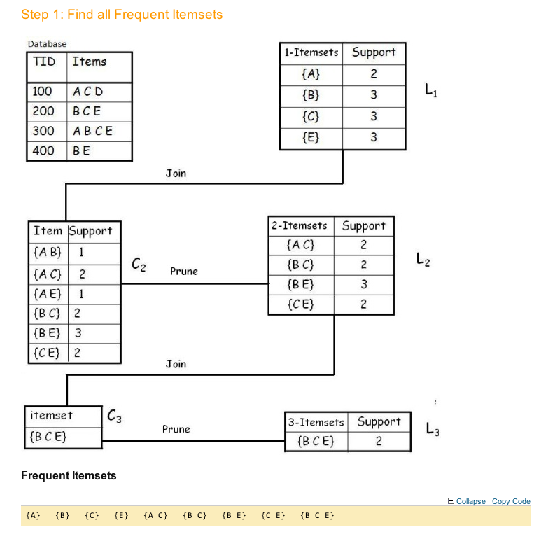

Slide 26
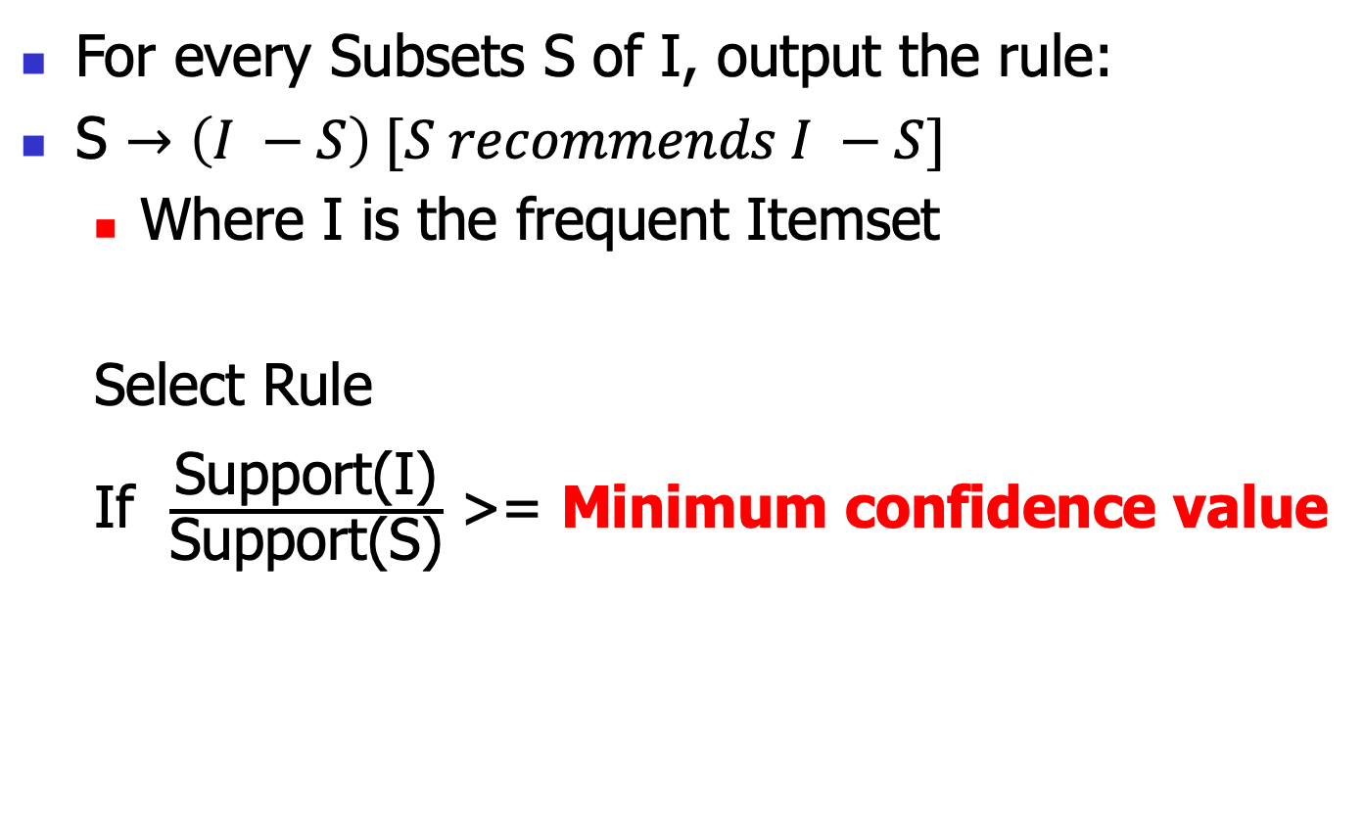
Step 2: Generate Association Rule

Slide 27
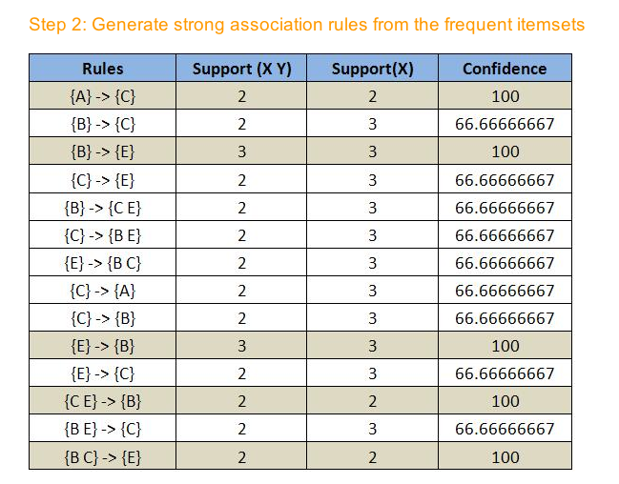

Slide 28
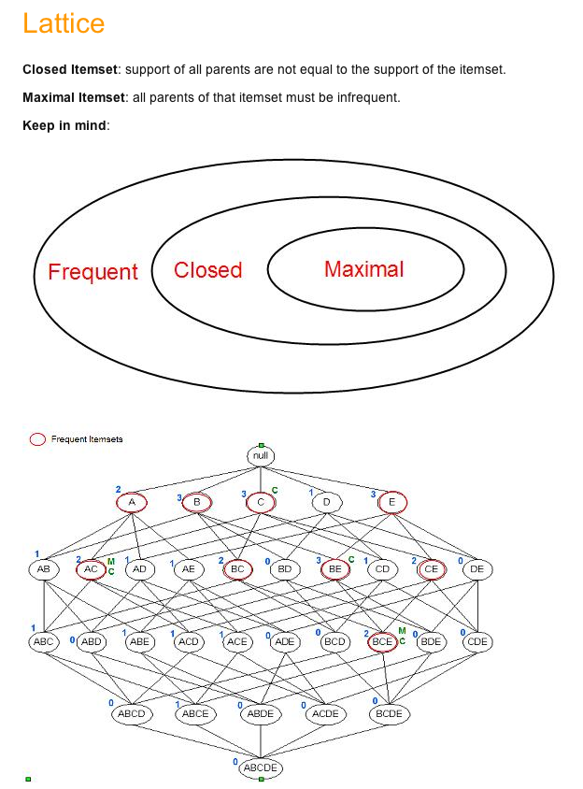

Slide 29
Candidate Generation: An SQL Implementation
SQL Implementation of candidate generation
  Suppose the items in L_{k-1} are listed in an order
  Step 1: self-joining L_{k-1}
    insert into C_{k}
    select p.item₁, p.item₂, …, p.item_{k-1}, q.item_{k-1}
    from L_{k-1} p, L_{k-1} q
    where p.item₁=q.item₁, …, p.item_{k-2}=q.item_{k-2}, p.item_{k-1} < q.item_{k-1}
  Step 2: pruning
    forall itemsets c in C_{k} do
      forall (k-1)-subsets s of c do
        if (s is not in L_{k-1}) then delete c from C_{k}
Use object-relational extensions like UDFs, BLOBs, and Table functions for efficient implementation [See: S. Sarawagi, S. Thomas, and R. Agrawal. Integrating association rule mining with relational database systems: Alternatives and implications. SIGMOD’98]

Slide 30
Scalable Frequent Itemset Mining Methods
30
Apriori: A Candidate Generation-and-Test Approach
Improving the Efficiency of Apriori
FPGrowth: A Frequent Pattern-Growth Approach
ECLAT: Frequent Pattern Mining with Vertical Data Format
Mining Close Frequent Patterns and Maxpatterns
Notes:
30

Slide 31
Further Improvement of the Apriori Method
Major computational challenges (Cons)
  Multiple scans of transaction database
  Huge number of candidates
  Tedious workload of support counting for candidates
Improving Apriori: general ideas
  Reduce passes of transaction database scans
  Shrink number of candidates
  Facilitate support counting of candidates

Slide 32
Partition: Scan Database Only Twice
Any itemset that is potentially frequent in DB must be frequent in at least one of the partitions of DB
  Scan 1: partition database and find local frequent patterns
  Scan 2: consolidate global frequent patterns
A. Savasere, E. Omiecinski and S. Navathe, VLDB’95
DB₁
+
DB₂
+
+
DB_{k}
= DB
sup₁(i) < σDB₁
sup₂(i) < σDB₂
sup_{k}(i) < σDB_{k}
sup(i) < σDB

Slide 33
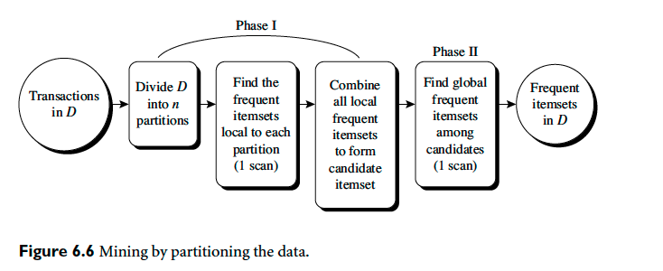
Partitioning

Slide 34
DHP: Reduce the Number of Candidates
A k-itemset whose corresponding hashing bucket count is below the threshold cannot be frequent
  Candidates: a, b, c, d, e
  Hash entries
    {ab, ad, ae}
    {bd, be, de}
    …
  Frequent 1-itemset: a, b, d, e
  ab is not a candidate 2-itemset if the sum of count of {ab, ad, ae} is below support threshold
J. Park, M. Chen, and P. Yu. An effective hash-based algorithm for mining association rules. SIGMOD’95
count
itemsets
35
{ab, ad, ae}
88
{bd, be, de}
...
...
102
{yz, qs, wt}
Hash Table

Slide 35
Sampling for Frequent Patterns
Select a sample of original database, mine frequent patterns within sample using Apriori
Scan database once to verify frequent itemsets found in sample, only borders of closure of frequent patterns are checked
  Example: check abcd instead of ab, ac, …, etc.
Scan database again to find missed frequent patterns
H. Toivonen. Sampling large databases for association rules. In VLDB’96

Slide 36
DIC: Reduce Number of Scans
ABCD
Once both A and D are determined frequent, the counting of AD begins
Once all length-2 subsets of BCD are determined frequent, the counting of BCD begins
ABC
ABD
ACD
BCD
AB
AC
BC
AD
BD
CD
Transactions
1-itemsets
A
B
C
D
Apriori
2-itemsets
…
{}
Itemset lattice
1-itemsets
2-items
S. Brin R. Motwani, J. Ullman, and S. Tsur. Dynamic itemset counting and implication rules for market basket data. SIGMOD’97
DIC
3-items

Slide 37
Scalable Frequent Itemset Mining Methods
37
Apriori: A Candidate Generation-and-Test Approach
Improving the Efficiency of Apriori
FPGrowth: A Frequent Pattern-Growth Approach
ECLAT: Frequent Pattern Mining with Vertical Data Format
Mining Close Frequent Patterns and Maxpatterns
Notes:
37

Slide 38
Pattern-Growth Approach: Mining Frequent Patterns Without Candidate Generation
Bottlenecks of the Apriori approach
  Breadth-first (i.e., level-wise) search
  Candidate generation and test
    Often generates a huge number of candidates
The FPGrowth Approach (J. Han, J. Pei, and Y. Yin, SIGMOD’ 00)
  Depth-first search
  Avoid explicit candidate generation
Major philosophy: Grow long patterns from short ones using local frequent items only
  “abc” is a frequent pattern
  Get all transactions having “abc”, i.e., project DB on abc: DB|abc
  “d” is a local frequent item in DB|abc → abcd is a frequent pattern

Slide 39
Construct FP-tree from a Transaction Database
TID Items bought (ordered) frequent items
100 {f, a, c, d, g, i, m, p} {f, c, a, m, p}
200 {a, b, c, f, l, m, o} {f, c, a, b, m}
300 {b, f, h, j, o, w} {f, b}
400 {b, c, k, s, p} {c, b, p}
500 {a, f, c, e, l, p, m, n} {f, c, a, m, p}
min_support = 3
{}
Header Table
Item frequency head
f 4
c 4
a 3
b 3
m 3
p 3
Scan DB once, find frequent 1-itemset (single item pattern)
Sort frequent items in frequency descending order, f-list
Scan DB again, construct FP-tree
f:4
c:1
c:3
b:1
b:1
a:3
p:1
m:2
b:1
F-list = f-c-a-b-m-p
p:2
m:1

Slide 40
Partition Patterns and Databases
Frequent patterns can be partitioned into subsets according to f-list
  F-list = f-c-a-b-m-p
  Patterns containing p
  Patterns having m but no p
  …
  Patterns having c but no a nor b, m, p
  Pattern f
Completeness and non-redundency

Slide 41
How the FP-tree is mined
The FP-tree is mined as follows:
  Start from each frequent length-1 pattern (as an initial suffix pattern),
  construct its conditional pattern base (a “sub-database,” which consists of the set of prefix paths in the FP-tree co-occurring with the suffix pattern),
  then construct its (conditional) FP-tree, and perform mining recursively on the tree.
  The pattern growth is achieved by the concatenation of the suffix pattern with the frequent patterns generated from a conditional FP-tree.

Slide 42
Find Patterns Having P From P-conditional Database
Starting at the frequent item header table in the FP-tree
Traverse the FP-tree by following the link of each frequent item p
Accumulate all of transformed prefix paths of item p to form p’s conditional pattern base
{}
Header Table
Item frequency head
f 4
c 4
a 3
b 3
m 3
p 3
f:4
c:1
Conditional pattern bases
item cond. pattern base
c f:3
a fc:3
b fca:1, f:1, c:1
m fca:2, fcab:1
p fcam:2, cb:1
c:3
b:1
b:1
a:3
p:1
m:2
b:1
p:2
m:1

Slide 43
From Conditional Pattern-bases to Conditional FP-trees
For each pattern-base
  Accumulate the count for each item in the base
  Construct the FP-tree for the frequent items of the pattern base
m-conditional pattern base:
  fca:2, fcab:1
{}
Header Table
Item frequency head
f 4
c 4
a 3
b 3
m 3
p 3
f:4
c:1
All frequent patterns relate to m
m,
fm, cm, am,
fcm, fam, cam,
fcam
{}
c:3
b:1
b:1

f:3

a:3
p:1
m:2
b:1
c:3
p:2
m:1
a:3
m-conditional FP-tree

Slide 44
Recursion: Mining Each Conditional FP-tree
{}
{}
Cond. pattern base of “am”: (fc:3)
f:3
c:3
f:3
am-conditional FP-tree
c:3
{}
Cond. pattern base of “cm”: (f:3)
a:3
f:3
m-conditional FP-tree
cm-conditional FP-tree
{}
Cond. pattern base of “cam”: (f:3)
f:3
cam-conditional FP-tree

Slide 45
A Special Case: Single Prefix Path in FP-tree
Suppose a (conditional) FP-tree T has a shared single prefix-path P
Mining can be decomposed into two parts
  Reduction of the single prefix path into one node
  Concatenation of the mining results of the two parts
{}
a₁:n₁
a₂:n₂
a₃:n₃
{}
r₁
b₁:m₁
C₁:k₁
a₁:n₁
+

r₁
=
b₁:m₁
C₁:k₁
a₂:n₂
C₂:k₂
C₃:k₃
a₃:n₃
C₂:k₂
C₃:k₃

Slide 46
Benefits of the FP-tree Structure
Completeness
  Preserve complete information for frequent pattern mining
  Never break a long pattern of any transaction
Compactness
  Reduce irrelevant info—infrequent items are gone
  Items in frequency descending order: the more frequently occurring, the more likely to be shared
  Never be larger than the original database (not count node-links and the count field)

Slide 47
The Frequent Pattern Growth Mining Method
Idea: Frequent pattern growth
  Recursively grow frequent patterns by pattern and database partition
Method
  For each frequent item, construct its conditional pattern-base, and then its conditional FP-tree
  Repeat the process on each newly created conditional FP-tree
  Until the resulting FP-tree is empty, or it contains only one path—single path will generate all the combinations of its sub-paths, each of which is a frequent pattern

Slide 48
Scaling FP-growth by Database Projection
What about if FP-tree cannot fit in memory?
  DB projection
First partition a database into a set of projected DBs
Then construct and mine FP-tree for each projected DB
Parallel projection vs. partition projection techniques
  Parallel projection
    Project the DB in parallel for each frequent item
    Parallel projection is space costly
    All the partitions can be processed in parallel
  Partition projection
    Partition the DB based on the ordered frequent items
    Passing the unprocessed parts to the subsequent partitions

Slide 49
Partition-Based Projection
Parallel projection needs a lot of disk space
Partition projection saves it
Tran. DB
fcamp
fcabm
fb
cbp
fcamp
p-proj DB
fcam
cb
fcam
m-proj DB
fcab
fca
fca
b-proj DB
f
cb
…
a-proj DB
fc
…
c-proj DB
f
…
f-proj DB
…
am-proj DB
fc
fc
fc
cm-proj DB
f
f
f
…

Slide 50
Performance of FPGrowth in Large Datasets
Data set T25I20D10K
Data set T25I20D100K
FP-Growth vs. Apriori
FP-Growth vs. Tree-Projection

Slide 51
Advantages of the Pattern Growth Approach
Divide-and-conquer:
  Decompose both the mining task and DB according to the frequent patterns obtained so far
  Lead to focused search of smaller databases
Other factors
  No candidate generation, no candidate test
  Compressed database: FP-tree structure
  No repeated scan of entire database
  Basic ops: counting local freq items and building sub FP-tree, no pattern search and matching
A good open-source implementation and refinement of FPGrowth
  FPGrowth+ (Grahne and J. Zhu, FIMI'03)

Slide 52
Further Improvements of Mining Methods
AFOPT (Liu, et al. @ KDD’03)
  A “push-right” method for mining condensed frequent pattern (CFP) tree
Carpenter (Pan, et al. @ KDD’03)
  Mine data sets with small rows but numerous columns
  Construct a row-enumeration tree for efficient mining
FPgrowth+ (Grahne and Zhu, FIMI’03)
  Efficiently Using Prefix-Trees in Mining Frequent Itemsets, Proc. ICDM'03 Int. Workshop on Frequent Itemset Mining Implementations (FIMI'03), Melbourne, FL, Nov. 2003
TD-Close (Liu, et al, SDM’06)

Slide 53
Extension of Pattern Growth Mining Methodology
Mining closed frequent itemsets and max-patterns
  CLOSET (DMKD’00), FPclose, and FPMax (Grahne & Zhu, Fimi’03)
Mining sequential patterns
  PrefixSpan (ICDE’01), CloSpan (SDM’03), BIDE (ICDE’04)
Mining graph patterns
  gSpan (ICDM’02), CloseGraph (KDD’03)
Constraint-based mining of frequent patterns
  Convertible constraints (ICDE’01), gPrune (PAKDD’03)
Computing iceberg data cubes with complex measures
  H-tree, H-cubing, and Star-cubing (SIGMOD’01, VLDB’03)
Pattern-growth-based Clustering
  MaPle (Pei, et al., ICDM’03)
Pattern-Growth-Based Classification
  Mining frequent and discriminative patterns (Cheng, et al, ICDE’07)

Slide 54
Scalable Frequent Itemset Mining Methods
Apriori: A Candidate Generation-and-Test Approach
Improving the Efficiency of Apriori
FPGrowth: A Frequent Pattern-Growth Approach
ECLAT: Frequent Pattern Mining with Vertical Data Format
Mining Close Frequent Patterns and Maxpatterns

Slide 55
ECLAT: Mining by Exploring Vertical Data Format
Vertical format: t(AB) = {T₁₁, T₂₅, …}
  tid-list: list of trans.-ids containing an itemset
Deriving frequent patterns based on vertical intersections
  t(X) = t(Y): X and Y always happen together
  t(X) ⊂ t(Y): transaction having X always has Y
Using diffset to accelerate mining
  Only keep track of differences of tids
  t(X) = {T₁, T₂, T₃}, t(XY) = {T₁, T₃}
  Diffset (XY, X) = {T₂}
Eclat (Zaki et al. @KDD’97)
Mining Closed patterns using vertical format: CHARM (Zaki & Hsiao@SDM’02)

Slide 56
Scalable Frequent Itemset Mining Methods
56
Apriori: A Candidate Generation-and-Test Approach
Improving the Efficiency of Apriori
FPGrowth: A Frequent Pattern-Growth Approach
ECLAT: Frequent Pattern Mining with Vertical Data Format
Mining Close Frequent Patterns and Maxpatterns
Notes:
56

Slide 57
Mining Frequent Closed Patterns: CLOSET
Flist: list of all frequent items in support ascending order
  Flist: d-a-f-e-c
Divide search space
  Patterns having d
  Patterns having d but no a, etc.
Find frequent closed pattern recursively
  Every transaction having d also has cfa → cfad is a frequent closed pattern
J. Pei, J. Han & R. Mao. “CLOSET: An Efficient Algorithm for Mining Frequent Closed Itemsets", DMKD'00.
Min_sup=2
TID | Items
10 | a, c, d, e, f
20 | a, b, e
30 | c, e, f
40 | a, c, d, f
50 | c, e, f

Slide 58
CLOSET+: Mining Closed Itemsets by Pattern-Growth
Itemset merging: if Y appears in every occurrence of X, then Y is merged with X
Sub-itemset pruning: if Y כ X, and sup(X) = sup(Y), X and all of X’s descendants in the set enumeration tree can be pruned
Hybrid tree projection
  Bottom-up physical tree-projection
  Top-down pseudo tree-projection
Item skipping: if a local frequent item has the same support in several header tables at different levels, one can prune it from the header table at higher levels
Efficient subset checking

Slide 59
MaxMiner: Mining Max-Patterns
1st scan: find frequent items
  A, B, C, D, E
2nd scan: find support for
  AB, AC, AD, AE, ABCDE
  BC, BD, BE, BCDE
  CD, CE, CDE, DE
Since BCDE is a max-pattern, no need to check BCD, BDE, CDE in later scan
R. Bayardo. Efficiently mining long patterns from databases. SIGMOD’98
Tid | Items
10 | A, B, C, D, E
20 | B, C, D, E,
30 | A, C, D, F
Potential max-patterns

Slide 60
CHARM: Mining by Exploring Vertical Data Format
Vertical format: t(AB) = {T₁₁, T₂₅, …}
  tid-list: list of trans.-ids containing an itemset
Deriving closed patterns based on vertical intersections
  t(X) = t(Y): X and Y always happen together
  t(X) ⊂ t(Y): transaction having X always has Y
Using diffset to accelerate mining
  Only keep track of differences of tids
  t(X) = {T₁, T₂, T₃}, t(XY) = {T₁, T₃}
  Diffset (XY, X) = {T₂}
Eclat/MaxEclat (Zaki et al. @KDD’97), VIPER(P. Shenoy et al.@SIGMOD’00), CHARM (Zaki & Hsiao@SDM’02)

Slide 61
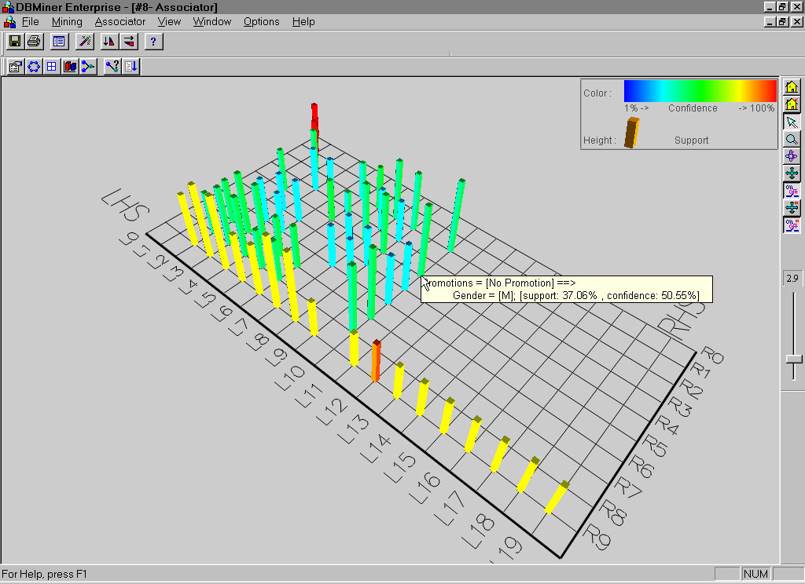
Visualization of Association Rules: Plane Graph

Slide 62
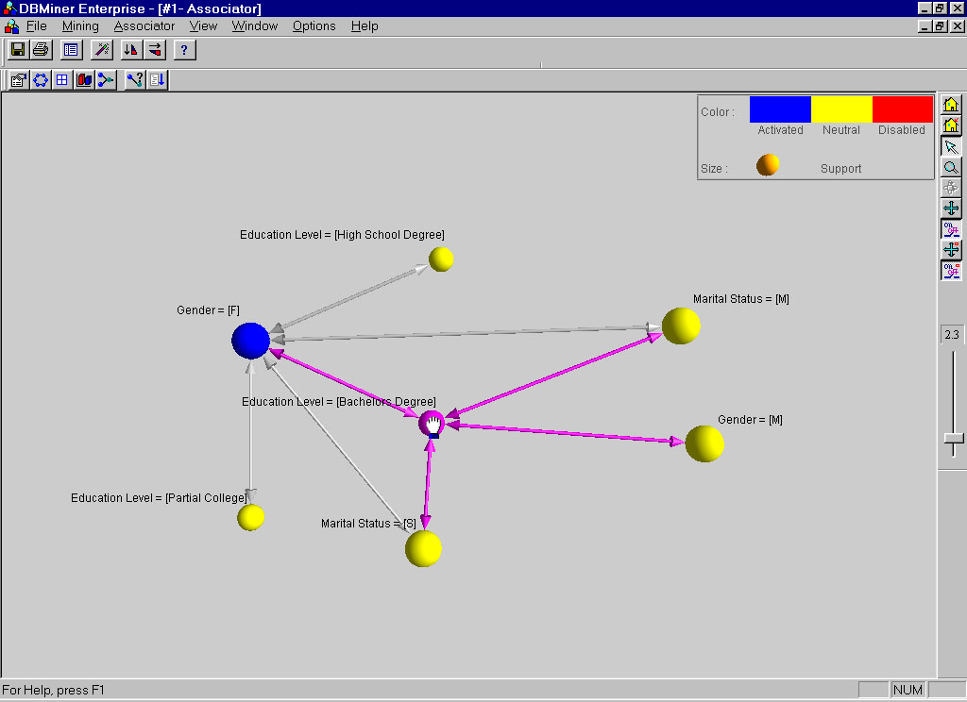
Visualization of Association Rules: Rule Graph

Slide 63
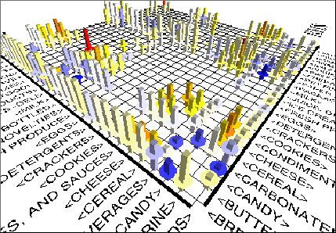
Visualization of Association Rules
(SGI/MineSet 3.0)

Slide 64
Chapter 5: Mining Frequent Patterns, Association and Correlations: Basic Concepts and Methods
Basic Concepts
Frequent Itemset Mining Methods
Which Patterns Are Interesting?—Pattern Evaluation Methods
Summary

Slide 65
Interestingness Measure: Correlations (Lift)
play basketball ⇒ eat cereal [40%, 66.7%] is misleading
  The overall % of students eating cereal is 75% > 66.7%.
play basketball ⇒ not eat cereal [20%, 33.3%]
is more accurate, although with lower support and confidence
Measure of dependent/correlated events: lift
 | Basketball | Not basketball | Sum (row)
Cereal | 2000 | 1750 | 3750
Not cereal | 1000 | 250 | 1250
Sum(col.) | 3000 | 2000 | 5000
using a minimum support of, say, 30%
and a minimum confidence of 60%

Slide 66
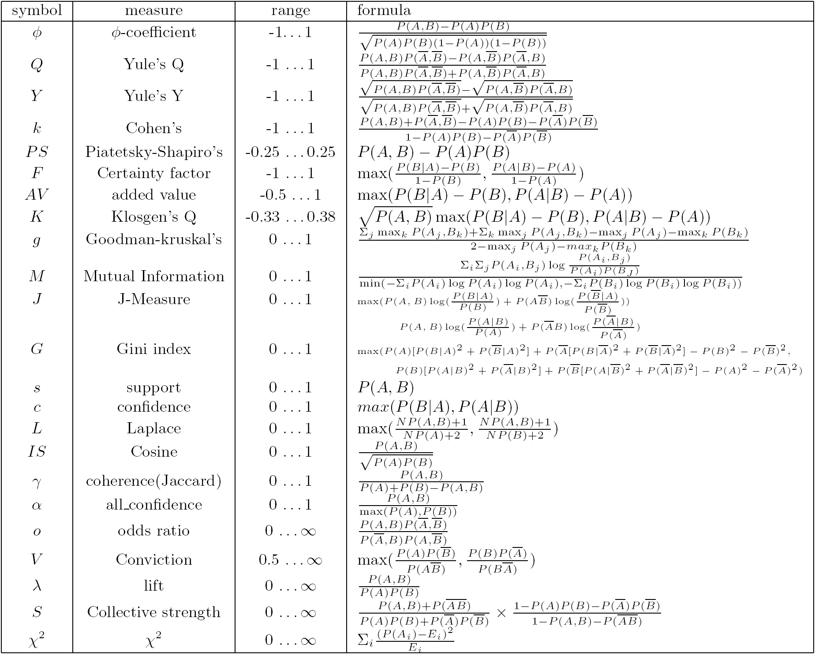
Are lift and χ² Good Measures of Correlation?
“Buy walnuts ⇒ buy milk [1%, 80%]” is misleading if 85% of customers buy milk
Support and confidence are not good to indicate correlations
Over 20 interestingness measures have been proposed (see Tan, Kumar, Sritastava @KDD’02)
Which are good ones?

Slide 67
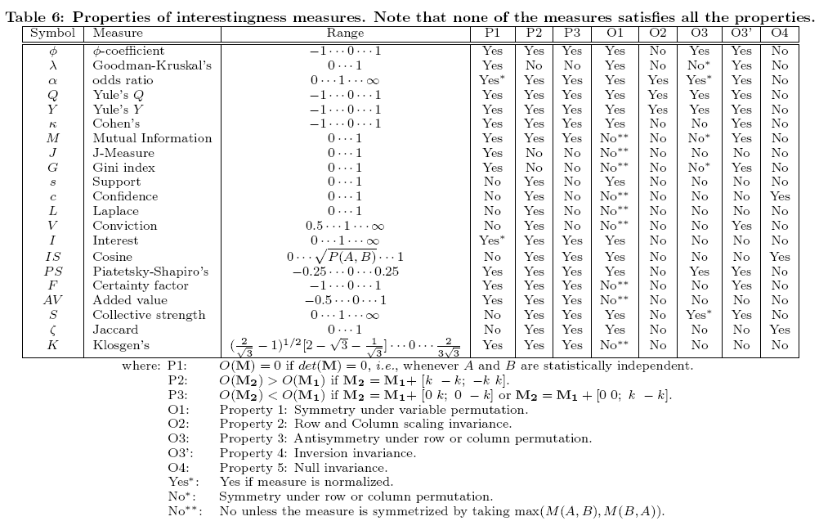
Null-Invariant Measures

Slide 68
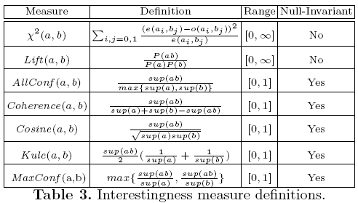
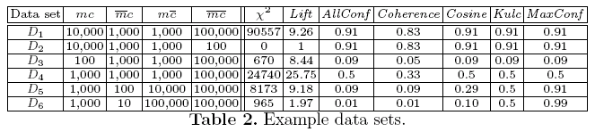
Comparison of Interestingness Measures
Null-(transaction) invariance is crucial for correlation analysis
Lift and χ² are not null-invariant
5 null-invariant measures
 | Milk | No Milk | Sum (row)
Coffee | m, c | ~m, c | c
No Coffee | m, ~c | ~m, ~c | ~c
Sum(col.) | m | ~m | Σ
Null-transactions w.r.t. m and c
Kulczynski measure (1927)
Null-invariant
Subtle: They disagree

Slide 69
Which Null-Invariant Measure Is Better?
IR (Imbalance Ratio): measure the imbalance of two itemsets A and B in rule implications
Kulczynski and Imbalance Ratio (IR) together present a clear picture for all the three datasets D₄ through D₆
  D₄ is balanced & neutral
  D₅ is imbalanced & neutral
  D₆ is very imbalanced & neutral

Slide 70
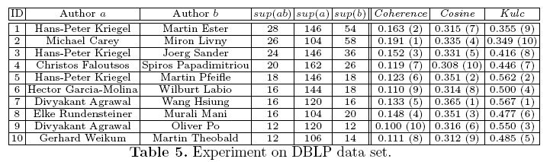
Analysis of DBLP Coauthor Relationships
Recent DB conferences, removing balanced associations, low sup, etc.
Advisor-advisee relation: Kulc: high, coherence: low, cosine: middle
Tianyi Wu, Yuguo Chen and Jiawei Han, “Association Mining in Large Databases: A Re-Examination of Its Measures”, Proc. 2007 Int. Conf. Principles and Practice of Knowledge Discovery in Databases (PKDD'07), Sept. 2007

Slide 71
Chapter 5: Mining Frequent Patterns, Association and Correlations: Basic Concepts and Methods
Basic Concepts
Frequent Itemset Mining Methods
Which Patterns Are Interesting?—Pattern Evaluation Methods
Summary

Slide 72
Summary
Basic concepts: association rules, support-confident framework, closed and max-patterns
Scalable frequent pattern mining methods
  Apriori (Candidate generation & test)
  Projection-based (FPgrowth, CLOSET+, ...)
  Vertical format approach (ECLAT, CHARM, ...)
Which patterns are interesting?
  Pattern evaluation methods

Slide 73
Ref: Basic Concepts of Frequent Pattern Mining
(Association Rules) R. Agrawal, T. Imielinski, and A. Swami. Mining association rules between sets of items in large databases. SIGMOD'93
(Max-pattern) R. J. Bayardo. Efficiently mining long patterns from databases. SIGMOD'98
(Closed-pattern) N. Pasquier, Y. Bastide, R. Taouil, and L. Lakhal. Discovering frequent closed itemsets for association rules. ICDT'99
(Sequential pattern) R. Agrawal and R. Srikant. Mining sequential patterns. ICDE'95

Slide 74
Ref: Apriori and Its Improvements
R. Agrawal and R. Srikant. Fast algorithms for mining association rules. VLDB'94
H. Mannila, H. Toivonen, and A. I. Verkamo. Efficient algorithms for discovering association rules. KDD'94
A. Savasere, E. Omiecinski, and S. Navathe. An efficient algorithm for mining association rules in large databases. VLDB'95
J. S. Park, M. S. Chen, and P. S. Yu. An effective hash-based algorithm for mining association rules. SIGMOD'95
H. Toivonen. Sampling large databases for association rules. VLDB'96
S. Brin, R. Motwani, J. D. Ullman, and S. Tsur. Dynamic itemset counting and implication rules for market basket analysis. SIGMOD'97
S. Sarawagi, S. Thomas, and R. Agrawal. Integrating association rule mining with relational database systems: Alternatives and implications. SIGMOD'98

Slide 75
Ref: Depth-First, Projection-Based FP Mining
R. Agarwal, C. Aggarwal, and V. V. V. Prasad. A tree projection algorithm for generation of frequent itemsets. J. Parallel and Distributed Computing, 2002.
G. Grahne and J. Zhu, Efficiently Using Prefix-Trees in Mining Frequent Itemsets, Proc. FIMI'03
B. Goethals and M. Zaki. An introduction to workshop on frequent itemset mining implementations. Proc. ICDM’03 Int. Workshop on Frequent Itemset Mining Implementations (FIMI’03), Melbourne, FL, Nov. 2003
J. Han, J. Pei, and Y. Yin. Mining frequent patterns without candidate generation. SIGMOD’ 00
J. Liu, Y. Pan, K. Wang, and J. Han. Mining Frequent Item Sets by Opportunistic Projection. KDD'02
J. Han, J. Wang, Y. Lu, and P. Tzvetkov. Mining Top-K Frequent Closed Patterns without Minimum Support. ICDM'02
J. Wang, J. Han, and J. Pei. CLOSET+: Searching for the Best Strategies for Mining Frequent Closed Itemsets. KDD'03

Slide 76
Ref: Vertical Format and Row Enumeration Methods
M. J. Zaki, S. Parthasarathy, M. Ogihara, and W. Li. Parallel algorithm for discovery of association rules. DAMI:97.
M. J. Zaki and C. J. Hsiao. CHARM: An Efficient Algorithm for Closed Itemset Mining, SDM'02.
C. Bucila, J. Gehrke, D. Kifer, and W. White. DualMiner: A Dual-Pruning Algorithm for Itemsets with Constraints. KDD’02.
F. Pan, G. Cong, A. K. H. Tung, J. Yang, and M. Zaki , CARPENTER: Finding Closed Patterns in Long Biological Datasets. KDD'03.
H. Liu, J. Han, D. Xin, and Z. Shao, Mining Interesting Patterns from Very High Dimensional Data: A Top-Down Row Enumeration Approach, SDM'06.

Slide 77
Ref: Mining Correlations and Interesting Rules
S. Brin, R. Motwani, and C. Silverstein. Beyond market basket: Generalizing association rules to correlations. SIGMOD'97.
M. Klemettinen, H. Mannila, P. Ronkainen, H. Toivonen, and A. I. Verkamo. Finding interesting rules from large sets of discovered association rules. CIKM'94.
R. J. Hilderman and H. J. Hamilton. Knowledge Discovery and Measures of Interest. Kluwer Academic, 2001.
C. Silverstein, S. Brin, R. Motwani, and J. Ullman. Scalable techniques for mining causal structures. VLDB'98.
P.-N. Tan, V. Kumar, and J. Srivastava. Selecting the Right Interestingness Measure for Association Patterns. KDD'02.
E. Omiecinski. Alternative Interest Measures for Mining Associations. TKDE’03.
T. Wu, Y. Chen, and J. Han, “Re-Examination of Interestingness Measures in Pattern Mining: A Unified Framework", Data Mining and Knowledge Discovery, 21(3):371-397, 2010

